Slide 1
MEDICINES & SIDE EFFECT ANALYSIS
TEAM
LOKESH.P
K.B. TIRUMALA RAYA
ARPIT JAIN
ARUNA.Y
PAVITHRA.G
SANDHYA RANI
YAMINI.R
FACULTY GUIDE
VINOD
HIMAVANTH

Slide 2
BUSINESS PROBLEM
THE CUSTOMERS ARE FACING AN ISSUE IN SELECTING A DRUG TO RECOVER FORM THE ILLNESS. HENCE IT IS MANDATORY TO CONSULT A DOCTOR TO GET THE CORRECT DRUG.
BUSINESS OBJECTIVE
This product could be helpful for companies like 1mg to provide detailed rating of the side effects of the product over their site. It could also be helpful for the patients who are buying drugs online to check the side effects of the drugs before buying it.

Slide 3
TOOLS AND LIBRARIES:
Typical graphical techniques used in EDA for our analysis are:
HISTOGRAM :- Is a approximate representation of the distribution of numerical data
SCATTER PLOT :- Is a type of plot or mathematical diagram using Cartesian coordinates to display values for typically 2 variables for a set of data
we have few set of libraries , these libraries are a set of useful function that eliminates the need for writing codes from scratch
PANDAS
NUMPY
SEABORN
TEXTBLOB
PYCONTARCTIONS
WORD CLOUD
MATPLOTLIB

Slide 4
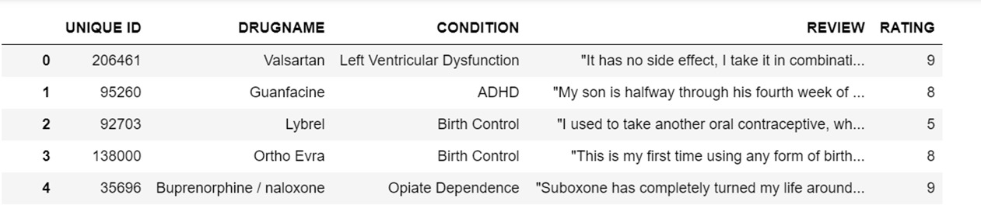
DATA SET

Slide 5
Data Set Details
In our data set we have 54741 rows and 6 columns
Columns Index and data type
unnamed:0’ ->(serial no’s) Numeric data type
Id->(drug id) Numeric data type
Drugname->(specific drug name) Text data type
Conditions ->(drug condition) Text data type
Reviews->(customer reviews) Text data type
Rating->(customer rating) Text data type
Unique drugs -> Unique drugs are 2576

Slide 6
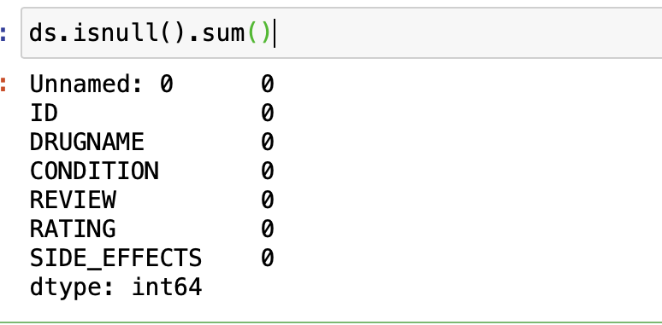
DATA SET DETAILS
It is a clearly shows that there is no null values or any missing values in our data set
EXPLANATION

Slide 7
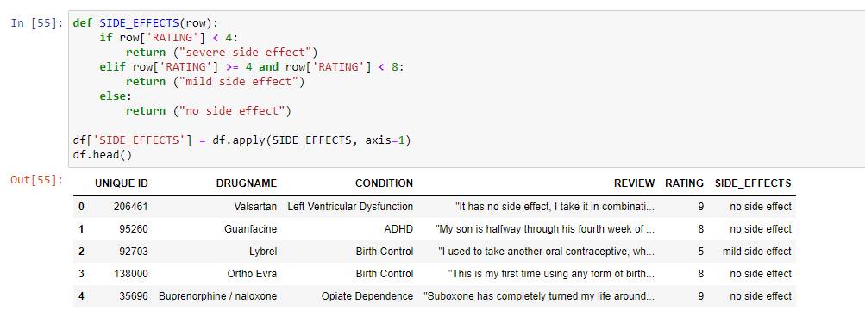
ADDING A NEW COLUMN:
We added side-effects column based on ratings of the customers
If rating is >=8 then no side effects
If rating is >= 4 then mild side effects
If rating is < 4 then severe side effects

Slide 8
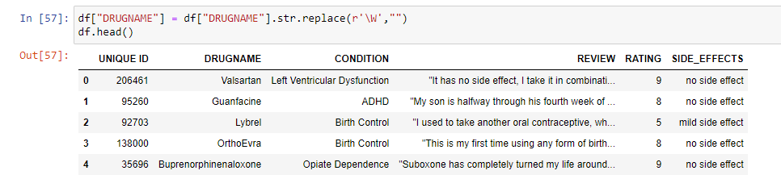
REPLACING SPECIAL CHARACTERS IN DRUGNAME COLUMN:
As there were few number of unwanted special characters in drugname all those were cleared
and above is the cleared dataset

Slide 9
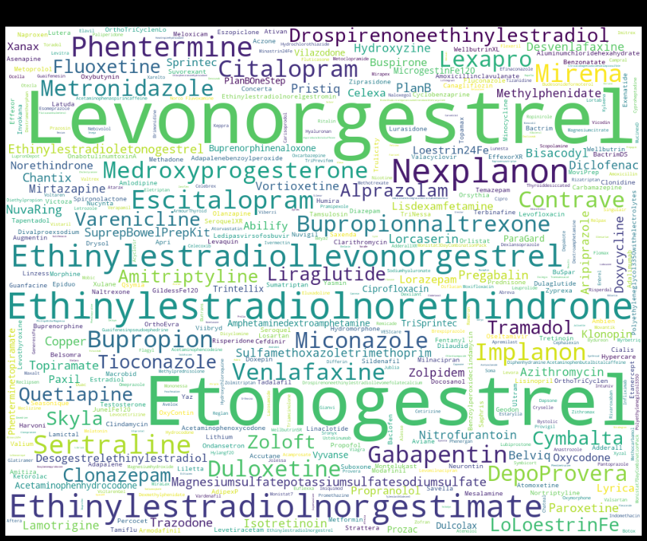
Word cloud for drug names
Word cloud for drug names
Here we can see the names of the drugs which are present in our dataset
We cleaned all the unwanted special characters, numbers.

Slide 10
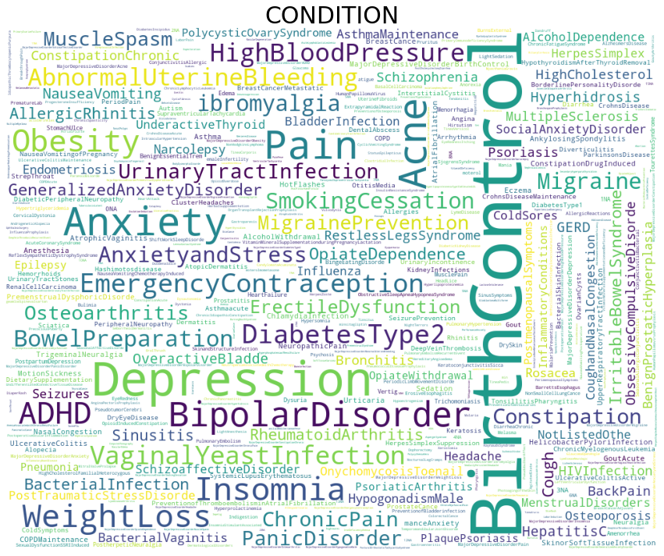
Word cloud for conditions
Wordcloud for conditions
In this image we can see word cloud for
conditions with respect to drugs.

Slide 11
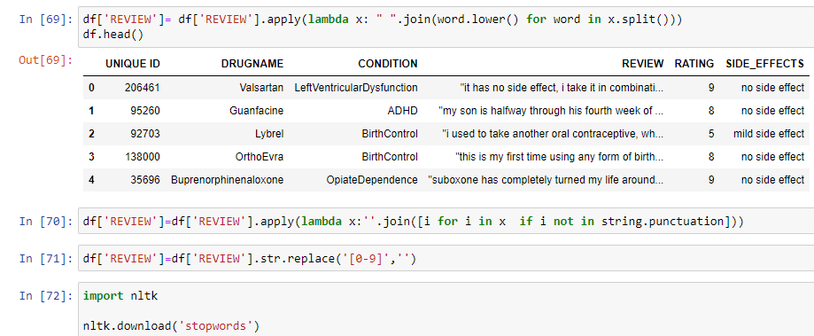
REMOVING ALL UNWANTED DATA:
Here we removed all the punctuations, numbers by applying lambda function.
And we converted all the reviews into lower case for better results.

Slide 12
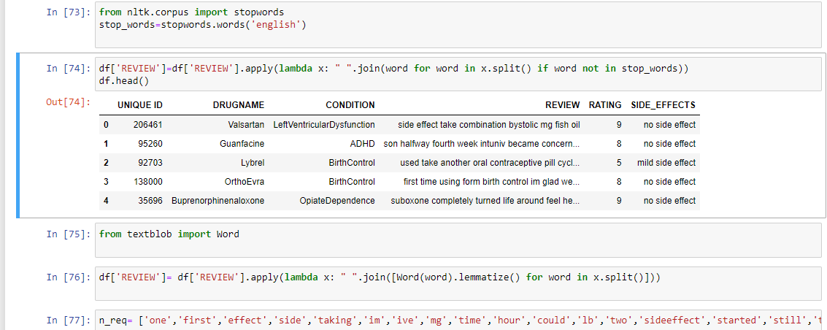
LEMMITIZATION:
Here we used lemmatization technique in order to remove all unnecessary words.
And by importing stopwords we removed all the stop words in reviews.

Slide 13
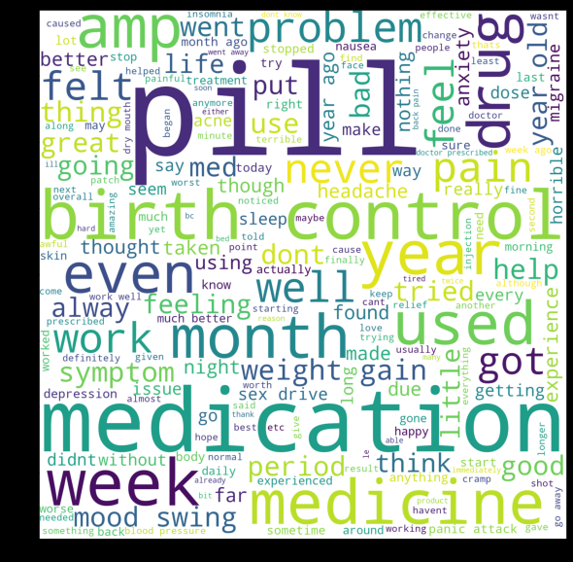
WORD CLOUD FOR REVIEWS:
This is the word cloud after removing all stop words,
punctuations, special characters, unneccessary words.

Slide 14
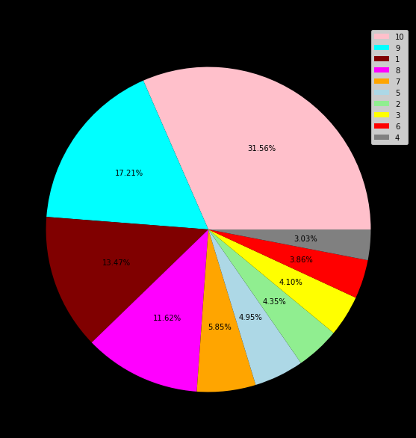
PIE CHART FOR RATINGS:
Here we have prepared a pie chart based on
values of ratings.
As we can see most of the ratings are good with
an average of 8,9 and 10.

Slide 15
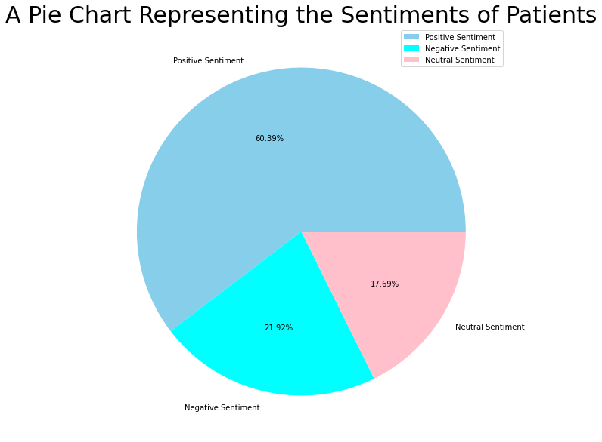
SENTIMENTAL ANALYSIS:
Here we applied sentimental label to get positive,
negative and neutral as results for ratings.
If ratings are >= 8 then the analysis will give positive sentiment.
If ratings are >= 4 then the analysis will give neutral sentiment.
If ratings are <4 then the analysis will give
negative sentiment.

Slide 16
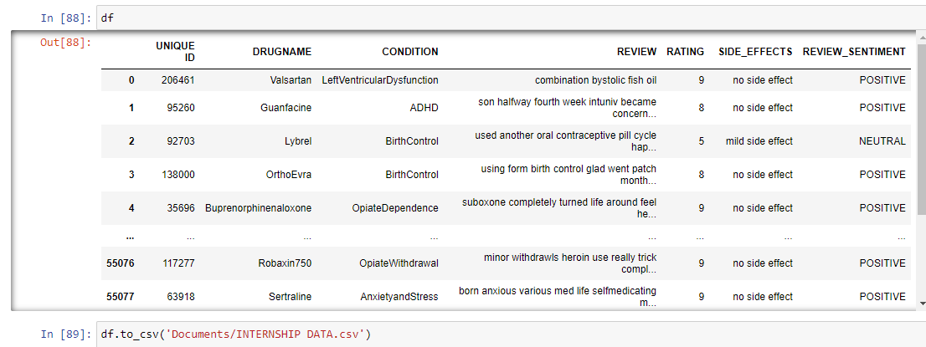
FINAL DATASET:

Slide 17

THANK YOU

